Slide 1
Introduction
CENG463

Slide 2
Learning
The phenomenon of knowledge acquisition in the absence of explicit programming.
To improve automatically with experience.

Slide 3
Representation
The more expressive the representation, the more training data the program will require in order to choose among the alternative hypotheses it can represent.

Slide 4
Dense vs. Sparse Representation
We want the complexity of learning the new concept to be related only to the number of variables that may be set in natural examples of it, and not on the cardinality of the universe of available variables.

Slide 5
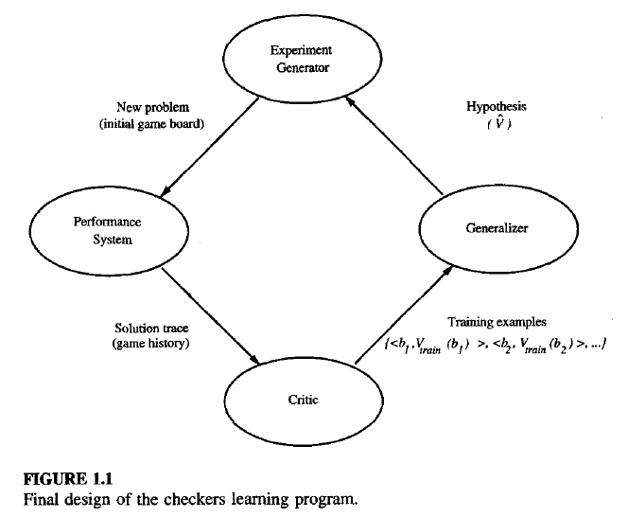

Slide 6
Learning
Learning denotes changes in the system that is adaptive in the sense that they enable the system to do the same task or tasks drawn from the same population more effectively the next time.
by H. Simon

Slide 7
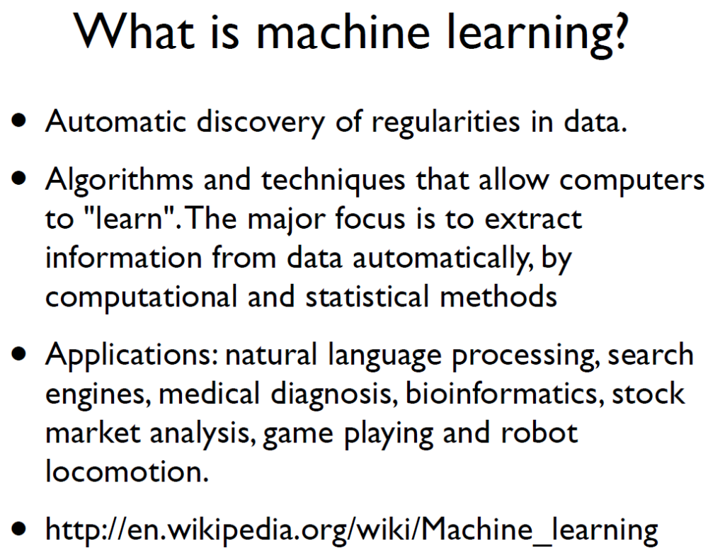

Slide 8
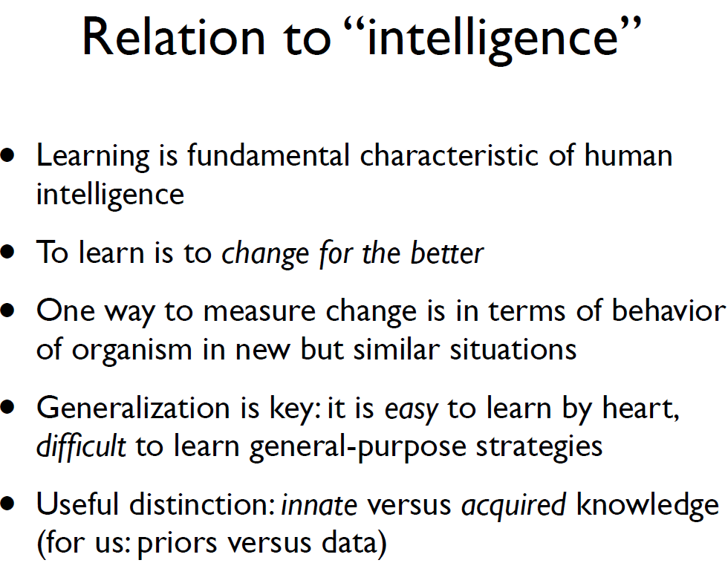

Slide 9
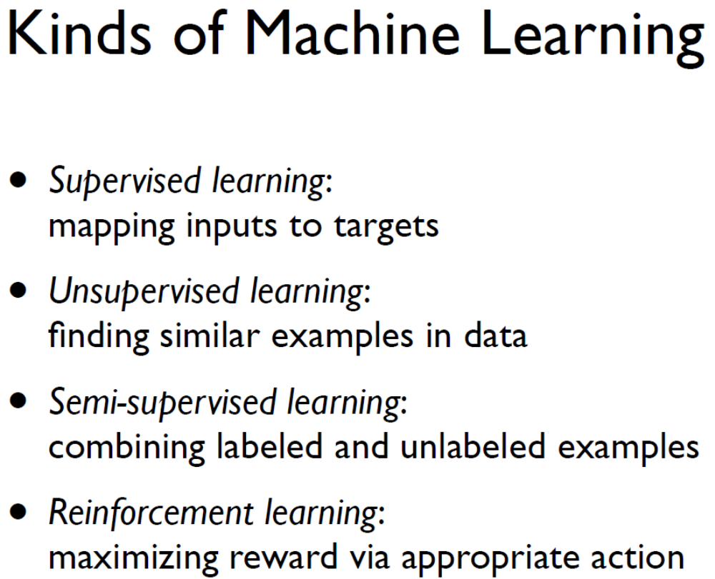

Slide 10
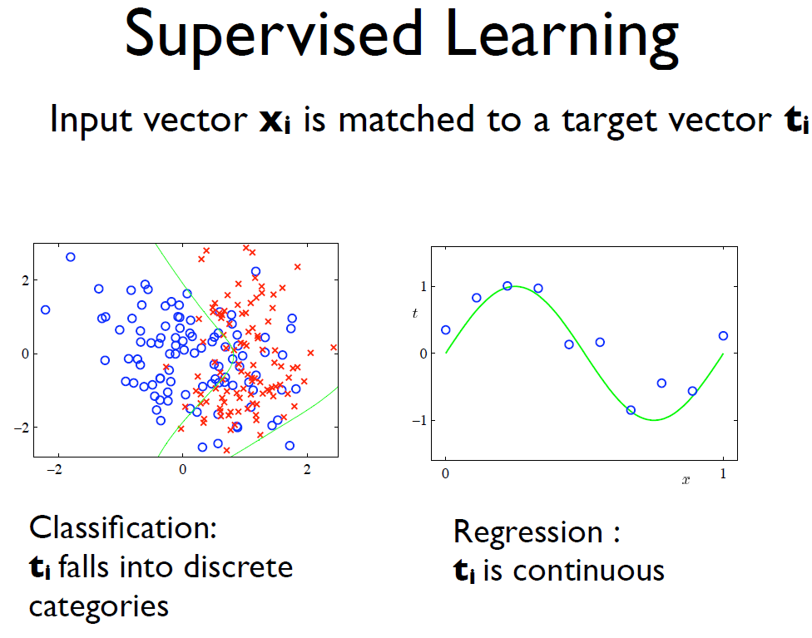

Slide 11
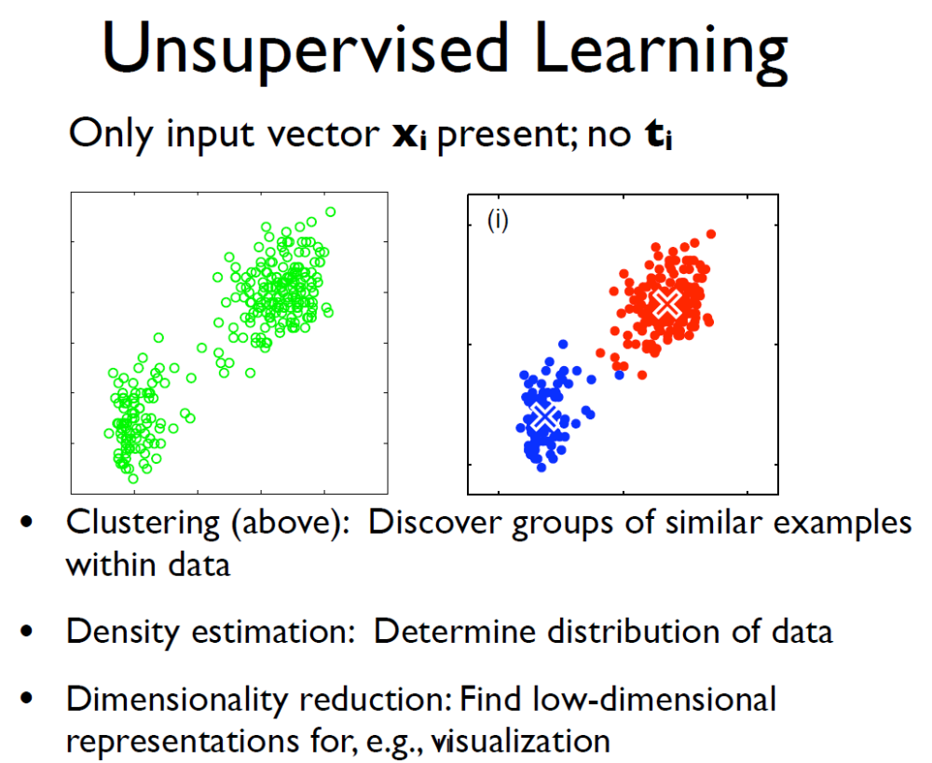

Slide 12
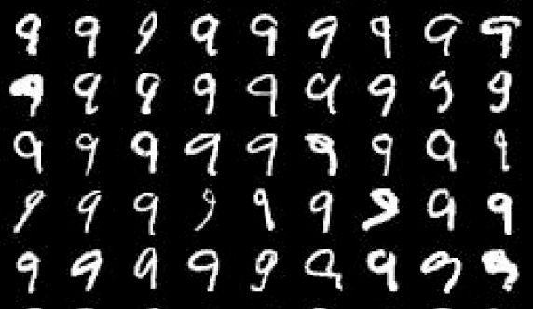
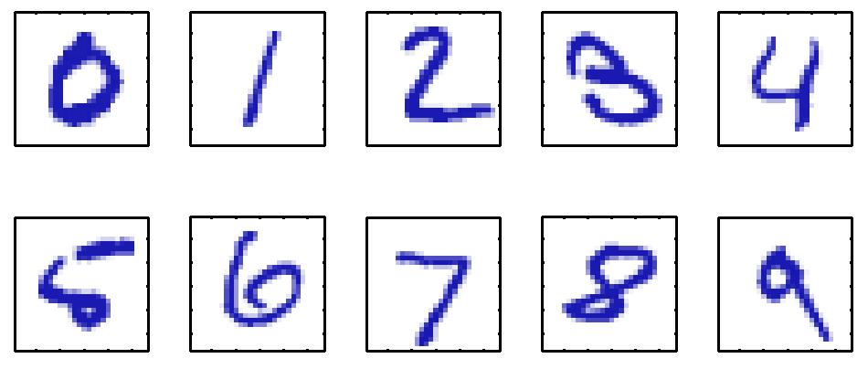
Example
Handwritten Digit Recognition
28
28
d=784
Pre-processing ← feature extraction
1. reduce variability ; 2. speed up computation

Slide 13
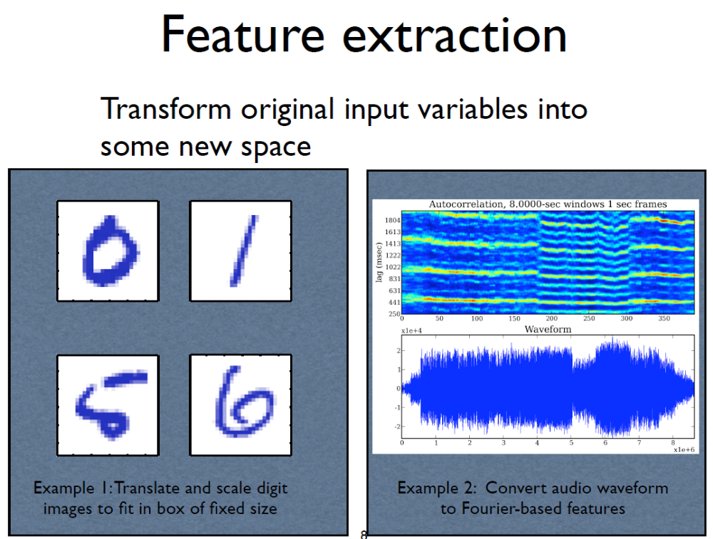

Slide 14
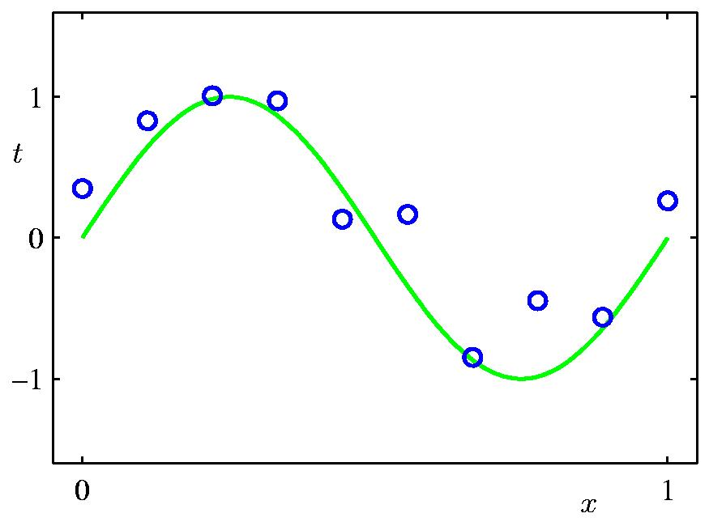
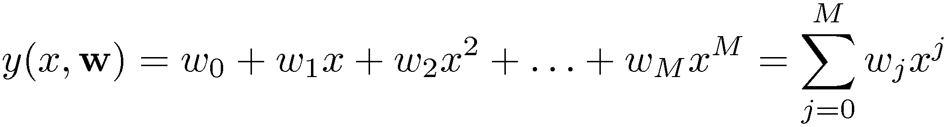
Polynomial Curve Fitting

Slide 15
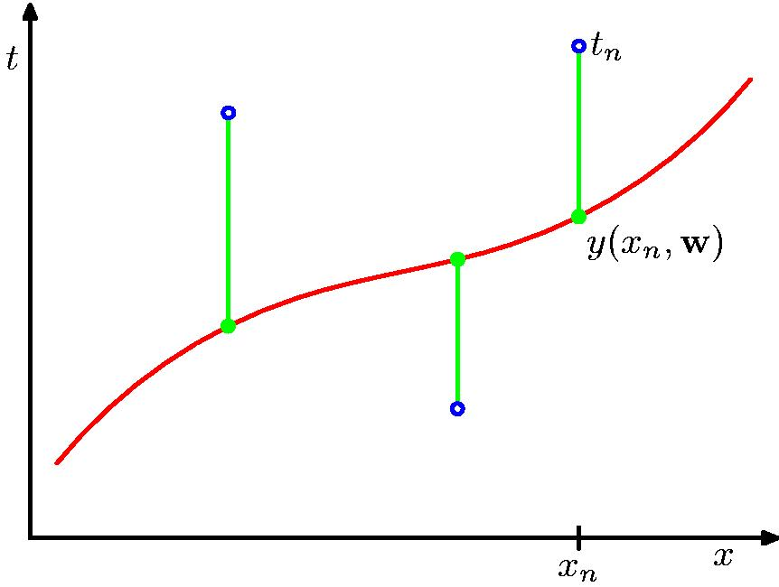
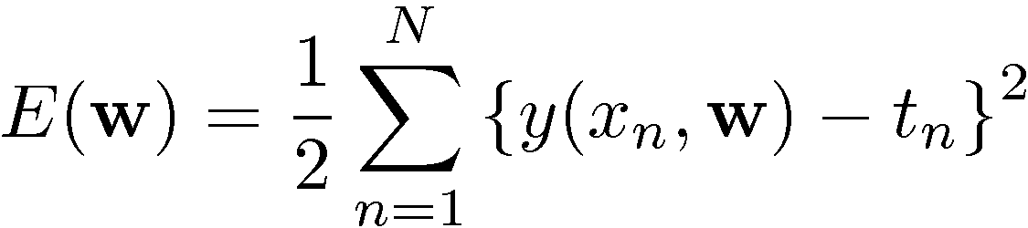
Sum-of-Squares Error Function

Slide 16
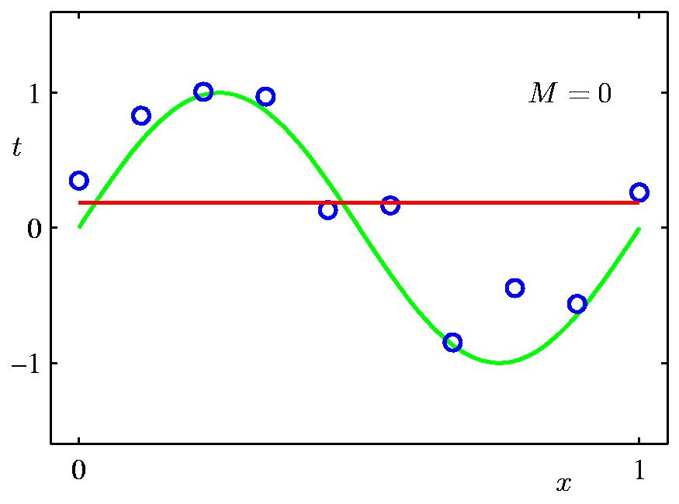
0th Order Polynomial

Slide 17
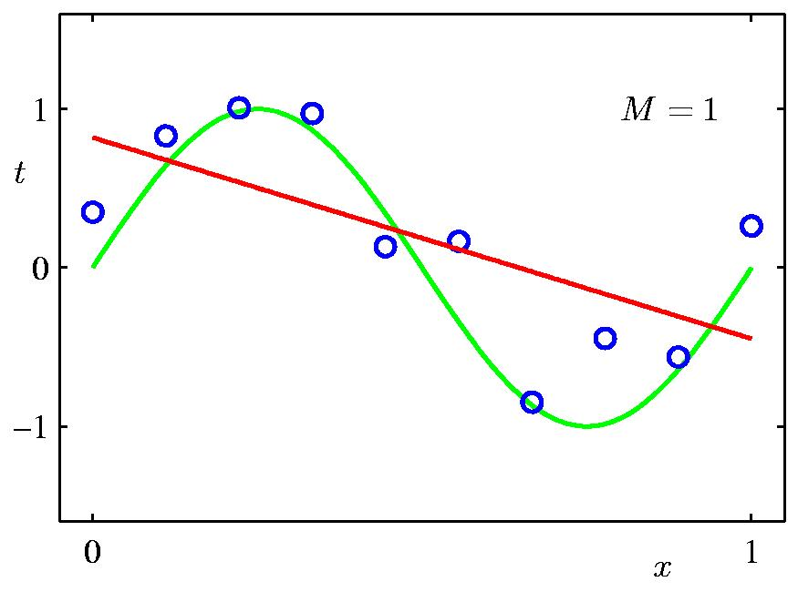
1st Order Polynomial

Slide 18
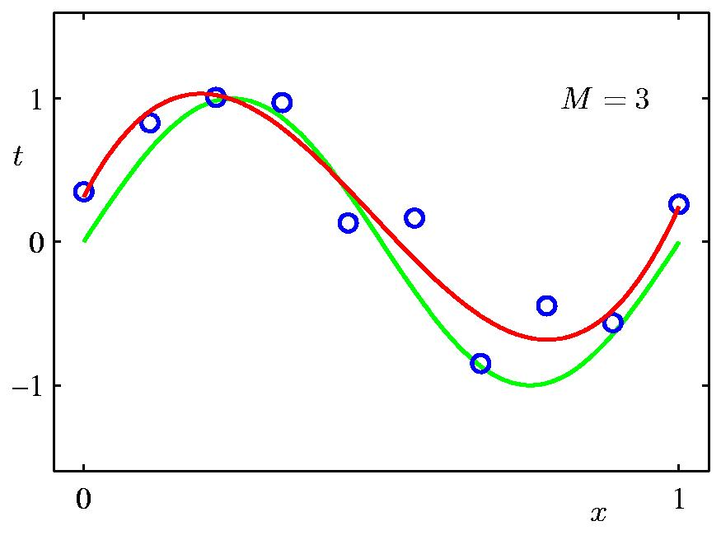
3rd Order Polynomial

Slide 19
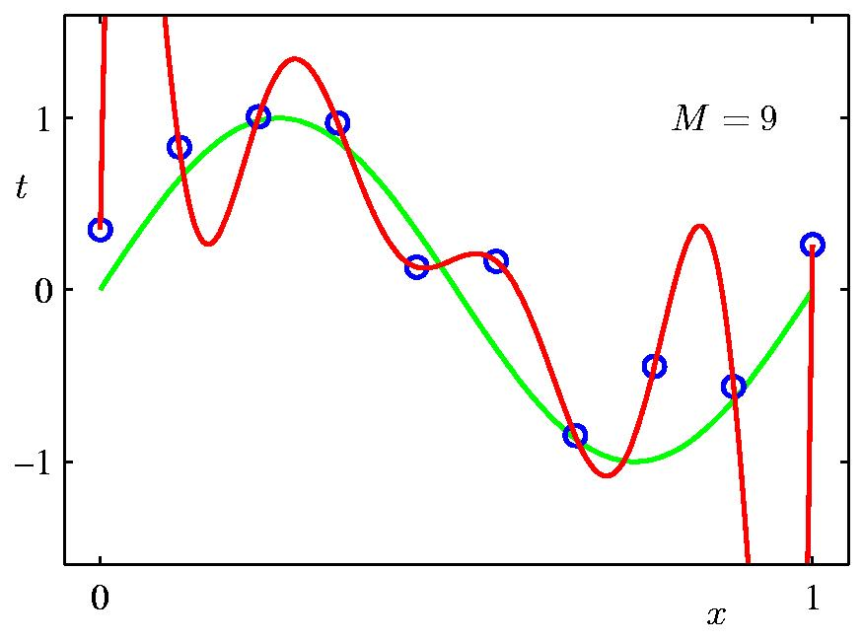
9th Order Polynomial

Slide 20
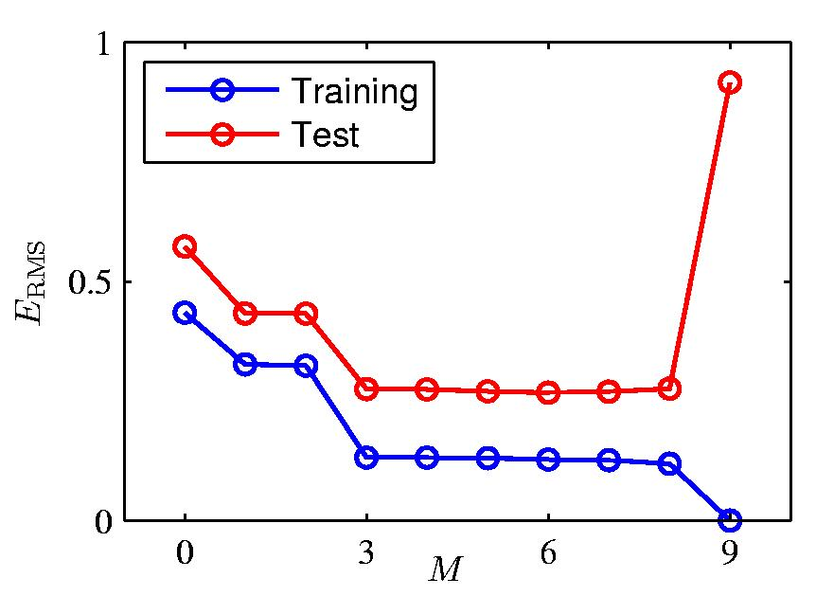
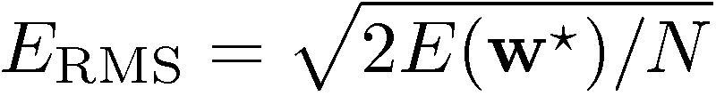
Over-fitting
Root-Mean-Square (RMS) Error:

Slide 21
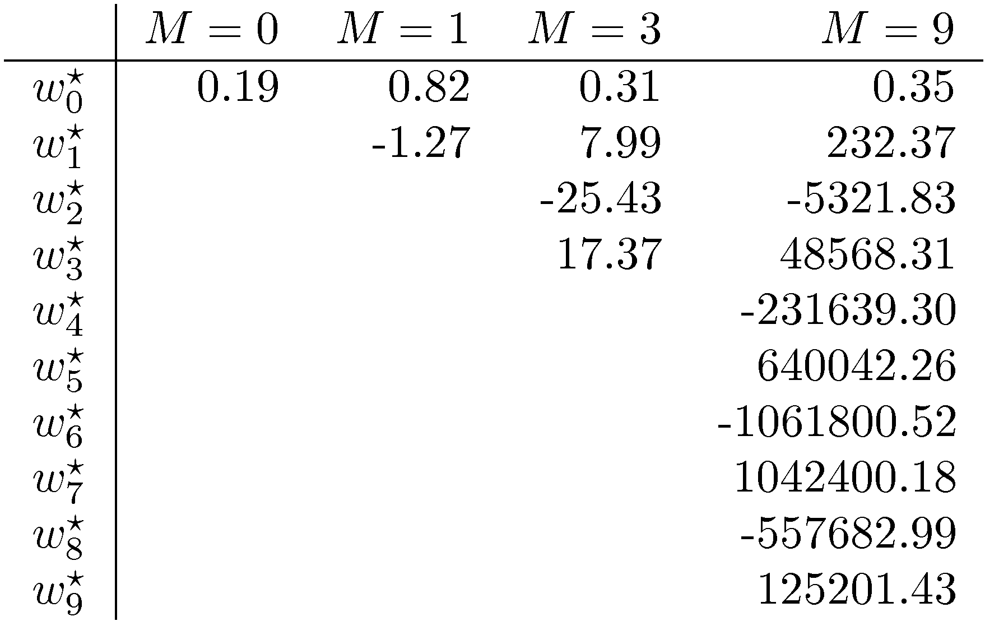
Polynomial Coefficients

Slide 22

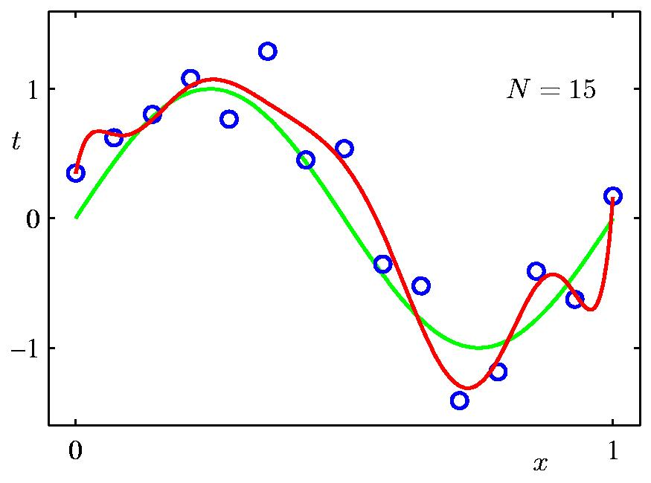
Data Set Size:
9th Order Polynomial

Slide 23

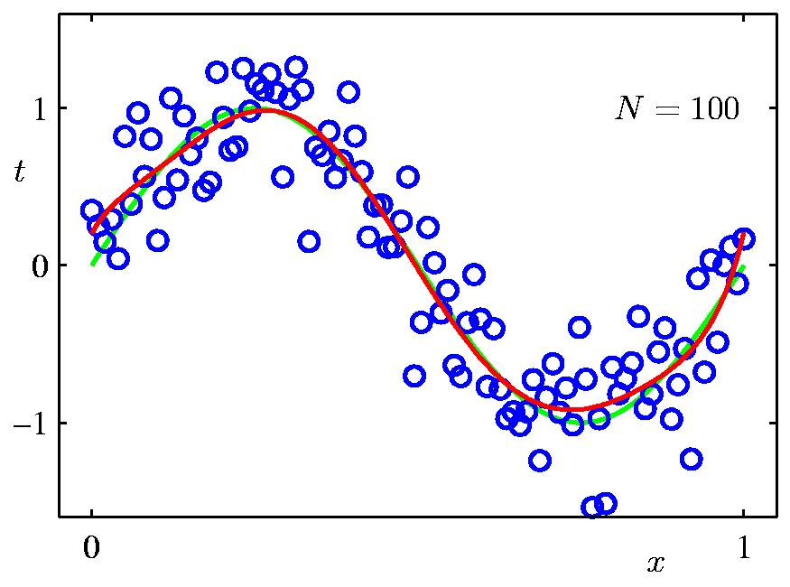
Data Set Size:
9th Order Polynomial

Slide 24
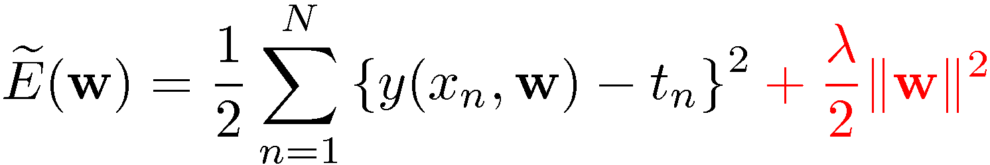
Regularization
Penalize large coefficient values

Slide 25

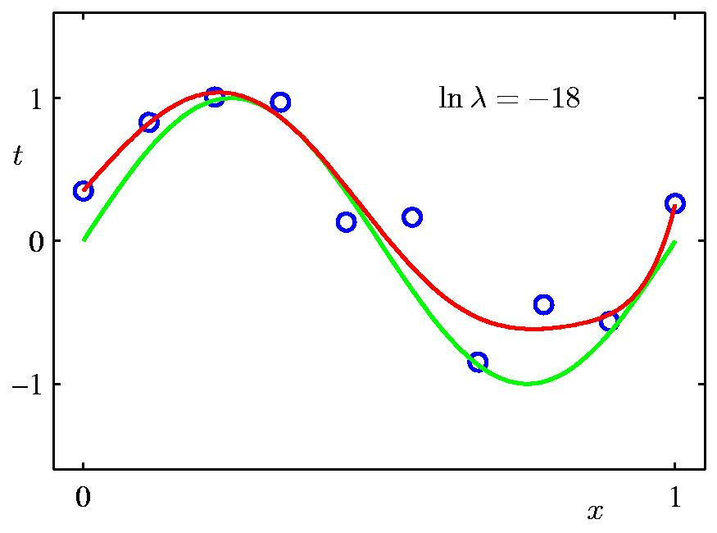
Regularization:

Slide 26

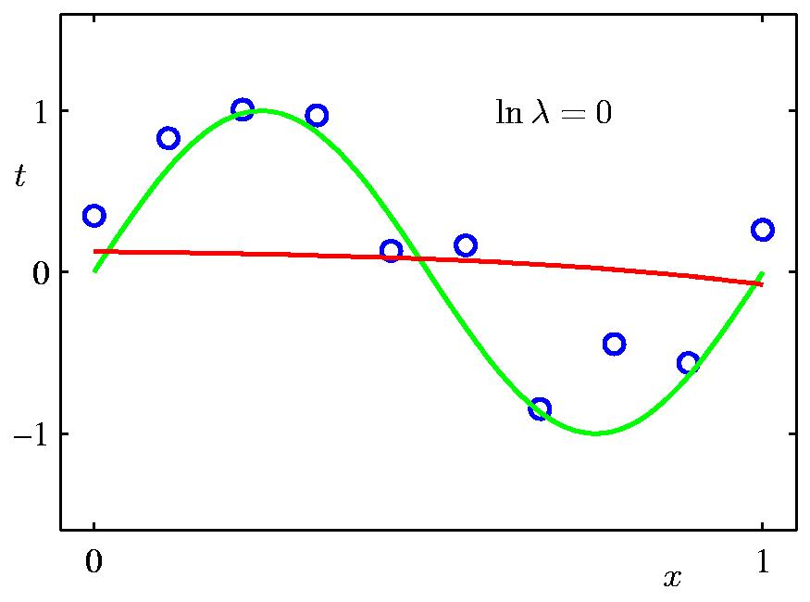
Regularization:

Slide 27


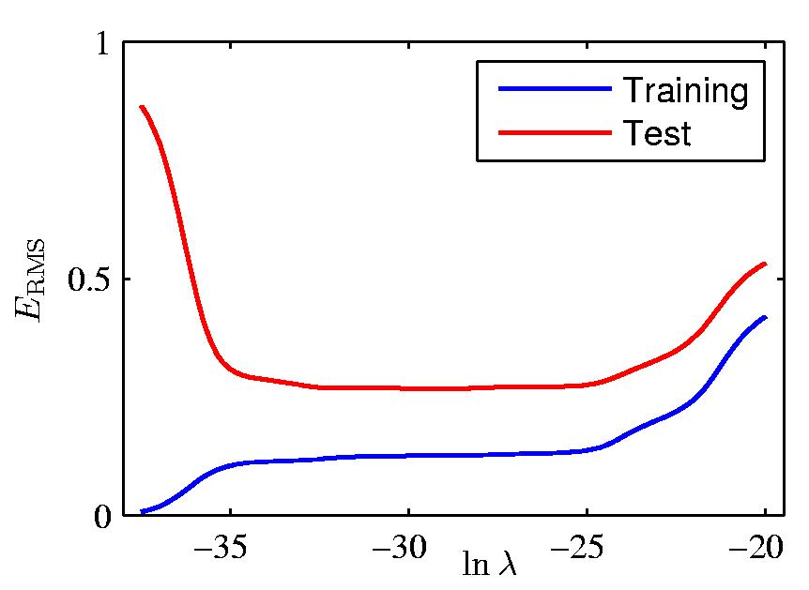
Regularization: vs.

Slide 28
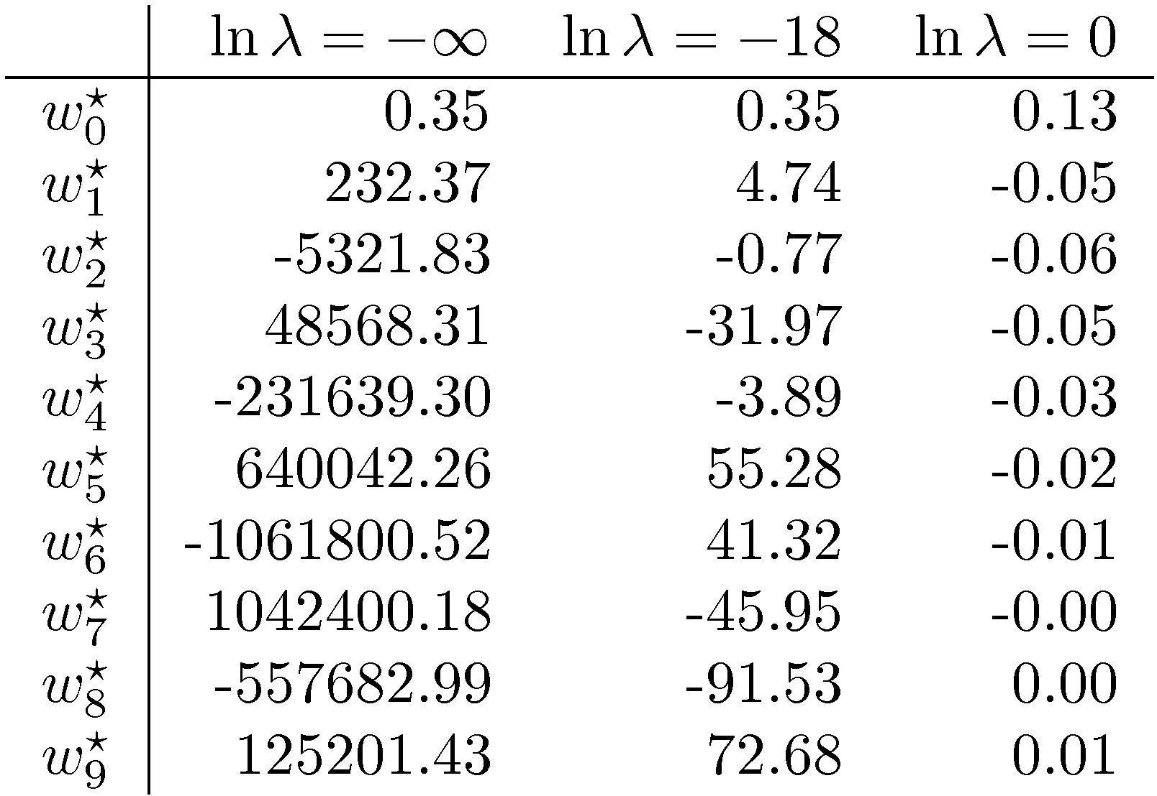
Polynomial Coefficients

